Slide 1
Email Templates
NOW TV Data Intelligence – Comms Delivery

Slide 2
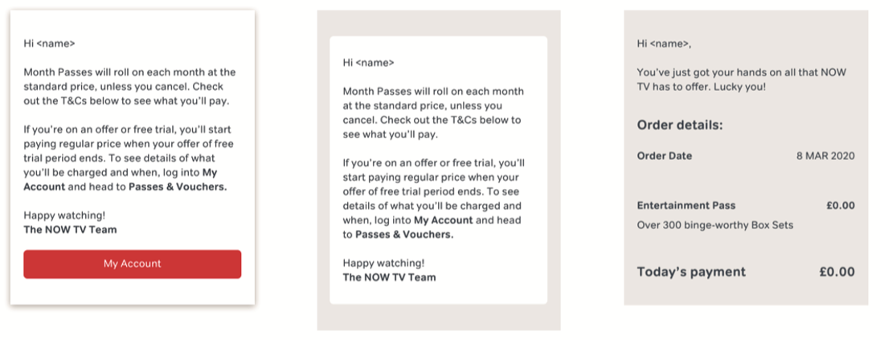
Service & Transcomms
Service comms
Service w. content
Transcomms

Slide 3



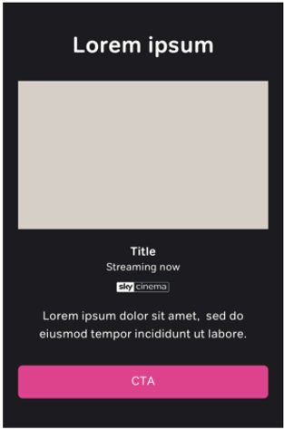
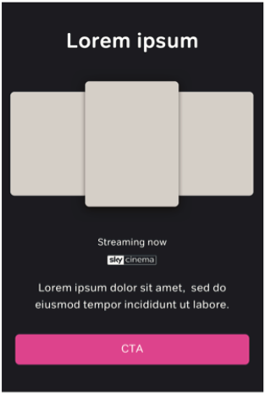
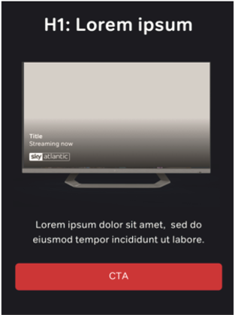
Hero Modules
HERO 1-2
HERO 1-3
HERO 1-4
HERO 2-1
HERO 2-2
HERO 2-3
HERO 2-4
Img: 1120x631
Img: 1120x631
Img: 1120x631
Img: 1200x1426

Slide 4


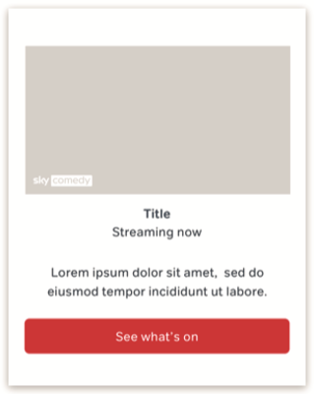
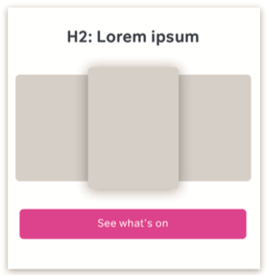
Secondary Modules
MOD 2-1
MOD 2-2
MOD 2-3
MOD 2-4
Img: 1120x631
Img: 420x622
Img: 1120x631
Img: 420x622

Slide 5




Secondary Modules
MOD 2-5
MOD 2-6
MOD 2-7
MOD 2-8
Img: 1120x631
Img: 1120x631
Img: 254x252
Img: 1120x631

Slide 6

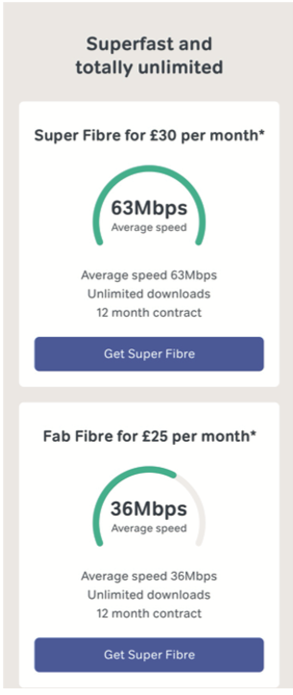
Secondary Modules
MOD 2-9
MOD 2-10

